Slide 1
PRESENTATION TITLE
LOAN PREDICTION
15-08-2022

Slide 2
TEXT LAYOUT 1
Agenda
Data Science Lifecycle​
Project Overview​
Data
Analysis
Modeling
Model Evaluation
Recommendations

Slide 3
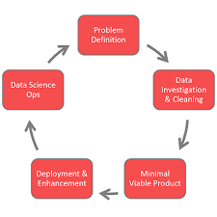
TEXT LAYOUT 1
Data Science Lifecycle

Slide 4
TEXT LAYOUT 1
Project Overview
Business Problem:
Business Objective:
Hypothesis:

Slide 5
TEXT LAYOUT 1
Project Overview
Business Problem:
Business Objective:
Hypothesis:

Slide 6
TEXT LAYOUT 1
Process Overview / Solution
Loading data
Cleaning data
Preprocessing data
Encoding Data
Feature Engineering
Model Selection
Model Deployment

Slide 7
TEXT LAYOUT 1
Data
The Data Given is raw data so it is filled with NaN Values. We need to replace nan values by applying statistical methods

Slide 8
TEXT LAYOUT 1
Analysis
RAW DATA -> EDA -> FEATURE ENGINEERING –>MODEL SELECTION-> FINDING GOOD MODEL

Slide 9
TEXT LAYOUT 1
Modeling
We have many Machine Learning Algorithms
Logistic Classification
Decision Tree Classification
Random Tree Classification

Slide 10
TEXT LAYOUT 1
Model Evaluation
Model Evaluation is done based on
Accuracy
MAE
TYPE – 1,2 errors

Slide 11
TEXT LAYOUT 1
Recommendations
No Recomendations

